Slide 1

Module 8: Working with Informatica Workflow Manager
0/5
Analytics: Data Warehouse Developer (Siebel 7.7)
Notes:
Time: Lecture: 40 minutes; labs: 20 – 30 minutes
Intent: To become familiar with Informatica Workflow Manager, which is the tool used to create, maintain, and test sessions and workflows that extract, transform, and load data.
Flow: Identify purpose of Informatica Workflow Manager; become familiar with Workflow Manager UI; review key terms; identify steps for creating and running workflows and sessions in Workflow Manager
Key Terms:
Session
Workflow
Scheduling
Monitoring
Session logs
8

Slide 2
Module Objectives
After completing this module you will be able to:
  Navigate Informatica Workflow Manager
  Navigate Informatica Workflow Monitor
  Run workflows and sessions using Informatica Workflow Manager
  Monitor workflows and sessions using Informatica Workflow Monitor
Why you need to know:
  Informatica Workflow Manager and Informatica Workflow Monitor are the tools you use to test and troubleshoot Informatica workflows that extract, transform, and load data
Notes:
Each objective and “why you need to know” should be stated aloud.
In the previous module, students learned the steps to build SDE and SIL mappings using Informatica Designer tools. In this module, they learn how to use Informatica Server Manager to add those mappings to sessions, and then run and monitor the sessions to load data.

Slide 3
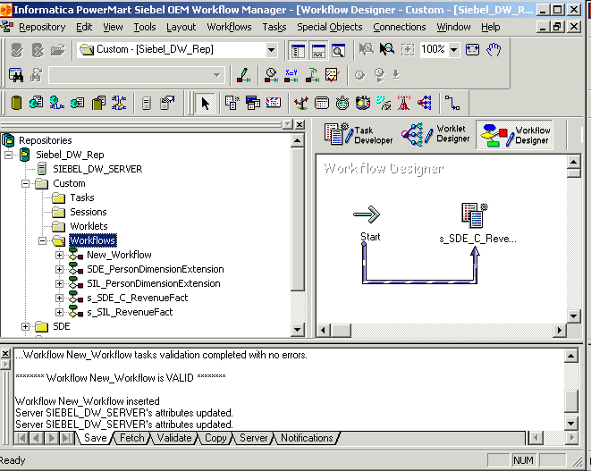
Informatica Workflow Manager
Is an Informatica client tool used to build workflows to execute mappings
Navigator:
View, select, and run workflows
Designer:
Create workflows
Output:
View messages from the Informatica server
Notes:
This slide explains the purpose of the Informatica Workflow Manager.
Students also used Workflow Manager to register Informatica servers in an earlier module. This module focuses on the steps needed to create, run, and monitor sessions and workflows.
8

Slide 4
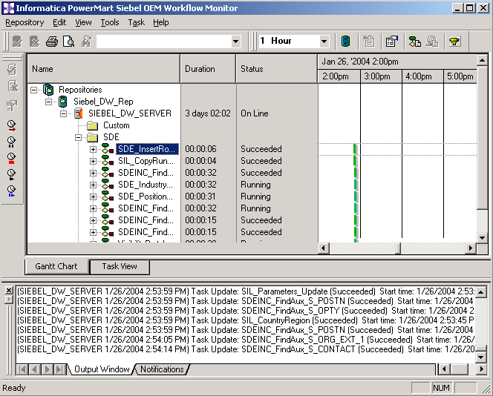
Workflow Monitor
Is an Informatica client tool used to monitor workflows and tasks
Navigator: Displays monitored repositories, servers, and repositories objects
Time: Displays progress of workflow runs
Output: Displays messages from Informatica Server and Repository Server
Gantt Chart: Displays details about workflow runs in Gantt Chart format
Task View: Displays details about workflow runs
Notes:
This slide explores the user interface of the Workflow Monitor, which is a client utility that allows polling of sessions and workflows running on the Informatica Server.

Slide 5
Key Terms
0/2
Workflow
Session
Notes:
This is a structuring slide. Do not teach the steps or concepts here because the following slides cover them in detail.
8

Slide 6
Workflow
1/2
Set of instructions that tells the Informatica Server how to execute tasks
Contains a session and any other tasks needed to execute a session
Notes:
A workflow is made up of tasks. The most common types of tasks used in SRMW are Start and Session tasks. The Start task represents the beginning of the workflow. The Session task is used to execute the mapping. The workflows are called by the DAC Server during ETL as their respective DAC tasks are prioritized for execution.
The Siebel Relationship Management Warehouse ships with prebuilt workflows and sessions used to extract data from the Siebel transactional database and load it into the SRMW.

Slide 7
Session
2/2
Set of instructions that tells the Informatica Server how and when to move data from sources to targets
Configured in the Workflow Manager by creating a session task
Executed as a task within a workflow
Notes:
Sessions have already been presented in prior modules. A session is the mechanism by which mappings move data from sources to targets. Mappings are added to sessions. When Informatica Server runs a session, it uses the instructions configured in the mapping to read, transform, and write data.
Students gain experience adding, running, and monitoring sessions in the labs for this module.
8

Slide 8
Creating and Running Workflows
0/10
Connect to repository
Add database connection
Open Workflow Designer
Create workflow
Add session to workflow
Link workflow tasks
Notes:
This is a structuring slide. Do not teach the steps or concepts here because the following slides cover them in detail.

Slide 9
Creating and Running Workflows Continued
0/10
Edit session properties
Run workflow
Monitor workflow progress
Check session log files
Notes:
This is a structuring slide. Do not teach the steps or concepts here because the following slides cover them in detail.
8

Slide 10
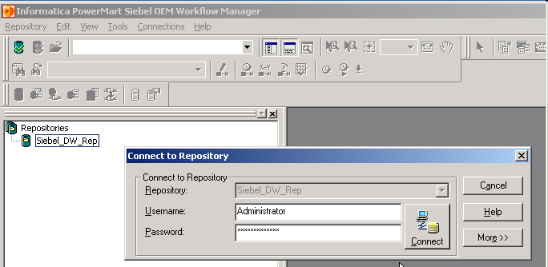
1. Connect to Repository
1/10
Open Workflow Manager and connect to desired repository
Double-click repository
Enter username and password and click Connect
Notes:
This slide identifies the steps to connect to a repository in Workflow Manager. Callouts provide details.

Slide 11
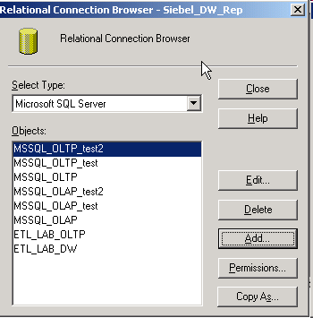
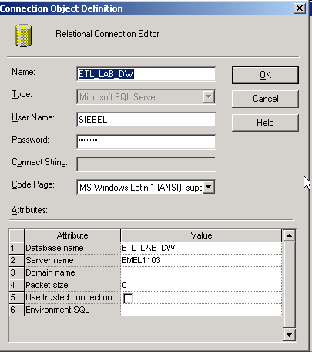
2. Add Database Connection
2/10
Select Connections > Relational to open the Relational Connection Browser
Enter connection values
Select database type
Click Add
Notes:
Students configured prebuilt database connections in previous labs.
8

Slide 12
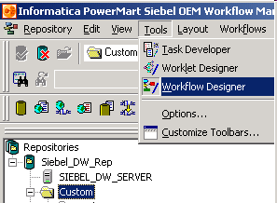
3. Open Workflow Designer
3/10
Select Tools > Workflow Designer to open Workflow Designer workspace
Notes:
This slide shows how to open the Workflow Designer workspace in the Workflow Manager.

Slide 13
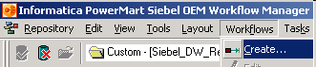
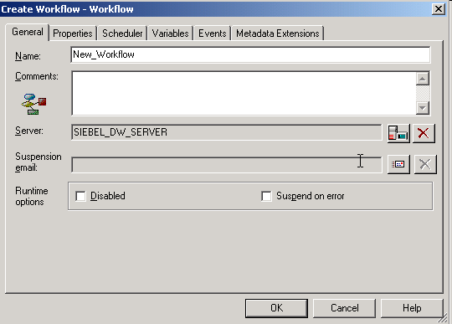
4. Create Workflow
4/10
Select Workflows > Create to create a new workflow
Name the workflow and click OK
Notes:
This slide shows how to create a new workflow in Workflow Designer.
8

Slide 14
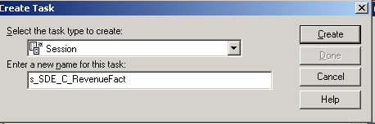
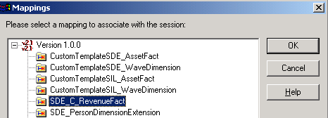
5. Add Session to Workflow
5/10
Select Tasks > Create to add a session to a workflow
Select Session type and enter a name for the task
Select mapping
Notes:
This slide shows how to create a new session in Workflow Designer.

Slide 15

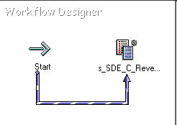
6. Link Workflow Tasks
6/10
Use Link Tasks button to link workflow tasks
Click Link Tasks button
Click Start task and drag link to session
Notes:
This slide shows how to link workflow tasks namely Start and Session tasks in the Workflow Designer.
8

Slide 16
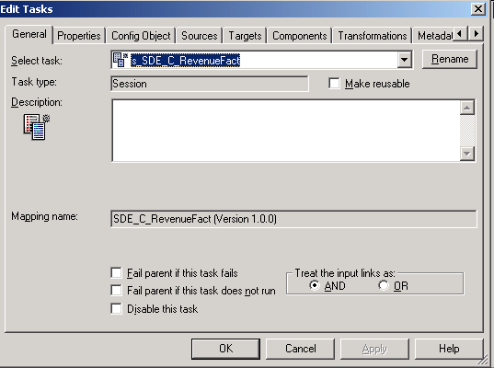
7. Edit Session Properties
7/10
Double-click session in Workflow Designer workspace to open Edit Tasks dialog window
Use Edit Tasks dialog window to edit session properties
Notes:
Students get practice of editing tasks in the labs. Session properties include source and target database connections, transformation source, bulk load options, and whether or not to truncate the target table.

Slide 17
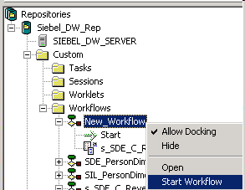
8. Run Workflow
8/10
Right-click workflow and select Start Workflow
Notes:
Once session properties are set, the workflow or session is added to the appropriate folder in the repository. Start workflows by right-clicking the workflow and then selecting Start Workflow.
8

Slide 18
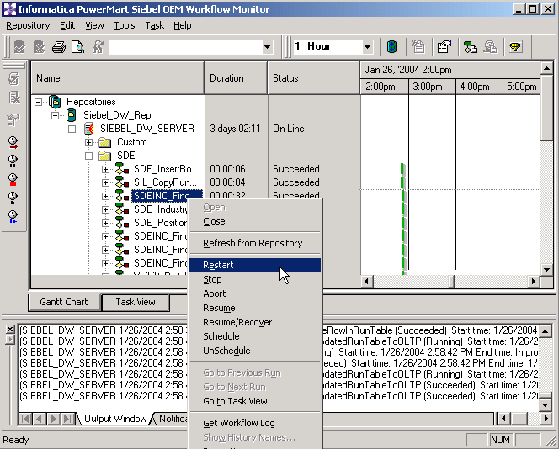
9. Monitor Workflow Progress
9/10
Use Workflow Monitor to run, stop, abort, resume, and monitor workflows
  Double-click Workflow Monitor icon in task tray to open Workflow Monitor
Workflow commands
Notes:
This slide shows how to open the Workflow Monitor to monitor progress of the workflow after it has been started. Students will practice this in the labs.

Slide 19
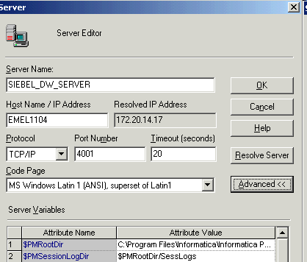
10. Check Session Log File
10/10
Generated for each session
Saved in the directory for the Informatica Server variable $PMSessionLogDir
Default name is session_name.log
Notes:
This slide shows how to locate Informatica session logs.
8

Slide 20
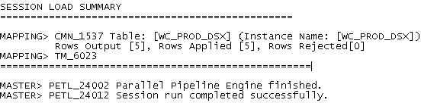
10. Check Session Log File Continued
10/10
Session log file includes:
  Allocation of system shared memory
  Execution of pre-session commands
  Session initialization
  Creation of SQL commands for reader and writer threads
  Start and end times for target loading
  Errors encountered during session
  Execution of post-session commands
  Load summary of reader, writer, and Data Transformation Manager (DTM) statistics
Notes:
Use log files to verify the success of a session or to troubleshoot sessions that fail.
Students get practice of using log files to verify sessions in the labs.

Slide 21
Summary
This module showed you how to:
  Navigate Informatica Workflow Manager
  Navigate Informatica Workflow Monitor
  Run workflows and sessions using Informatica Workflow Manager
  Monitor workflows and sessions using Informatica Workflow Monitor
Notes:
This slide presents a summary of the topics covered in the module.
Review Questions:
Question: True or False. Informatica Server Manager is used to create, run, monitor, and maintain mappings that extract, transform, and load data.
Answer: False. Informatica Server Manager is used to create, run, monitor, and maintain sessions and batches that extract, transform, and load data. Mappings are added to sessions and batches.
Question: True or False. A session task is made up of workflows.
Answer: False. A workflow is made up of one or more session tasks or other task types. A session is the mechanism by which mappings move data from sources to targets.
8

Slide 22
Lab
In the lab you will:
  Create sessions and workflows in the Custom folder of the Informatica repository that use the SDE and SIL mappings you created in previous labs
Notes:
Labs and Troubleshooting:
In lab 8-1, students create and run sessions and workflows that use the SDE and SIL mappings created in labs 7-1 and 7-2. The expected result in Lab 8-1 is five rows of data first in the WC_RVF_FS fact staging table and then in the WC_RVF_F fact table.
The success of Lab 8-1 depends on students having correctly built the SDE and SIL mappings in labs 7-1 and 7-2. Be prepared to troubleshoot these mappings and or workflows if the sessions do not run successfully.
If troubleshooting is unsuccessful, use the provided workflow solutions that go with mapping solutions of Lab 7-1 and 7-2. The workflow solution file names are noted below. Import workflow solutions into the repository in Informatica Workflow Manager by selecting Repository > Import Objects. If necessary, rename the workflow solutions when importing. It is important that mapping and workflow solution files are used together.
Files:
s_SDE_C_RevenueFact After Lab 9 - Workflow.XML s_SIL_C_RevenueFact After Lab 9 - Workflow.XML
The important take-away from these labs and the labs from the previous module is the practice of building the mappings and running workflows, and understanding the purpose of the mappings. Do not let students become frustrated if they do not see the expected results after running sessions. Be prepared to answer questions, provide the solutions if necessary, but move on to the next module.

